Slide 1
Lecture-3
C++
Coding Blocks
Recursion
Kartik Mathur

Slide 2
Warm Up?
Multiply two numbers X and Y without using
*(Multiply ) operator, using recursion ?
Convert String to an integer ?
“12345” to 12345.
Find first and last index of 7 in an array. You need to start search from the index 0. In both the cases.

Slide 3
Find all subsequence of a string
“abc” – “”, “a”, “b”, “c”, “ab”, “ac”, “bc”, “abc”
Before we think about recursive solution lets look at few things:
We need this function to return an array of strings.
But in C++ we know we cannot return array as this would be address of local variable.
Instead we can pass it as argument and expect it to fill this array with the strings.
We also need to know how many strings in this array were filled by the function so that we can iterate over it and print it.

Slide 4
Lets find recursion in it.
S(“”) – [“”]
S(“c”) – [“”, “c”]
S(“bc”) – [“”, “c”, “b”, “bc”]
S(“abc”) – [“”, “c”, “b”, “bc”, “a”, “ac”, “ab”, “abc”]
Figured out?
S(“abc”) = S(“bc”) + copy of all S(“bc”) with ‘a’ prefixed.
Notes:
Talk about the

Slide 5
Time to code.

Slide 6
Permutations of a String.
Notes:
Talk about inserting ith element at all positions.

Slide 7
What if the problem statement changed to just save all permutations instead of printing ?
Notes:
Talk about tree recursion! And code the above.

Slide 8
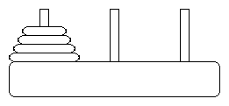
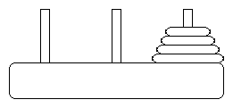
Towers of Hanoi !
Initial State
Final State

Slide 9
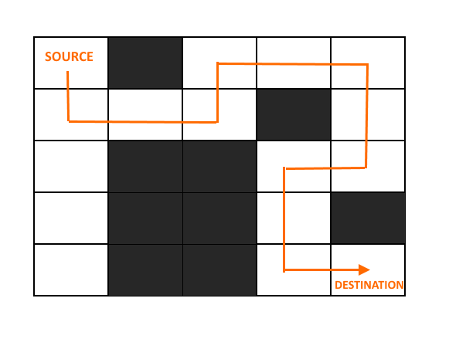
Rat in a Maze Problem

Slide 10
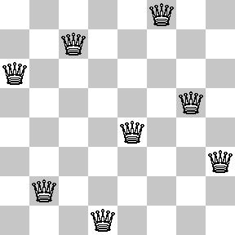
N – Queens Problem

Slide 11
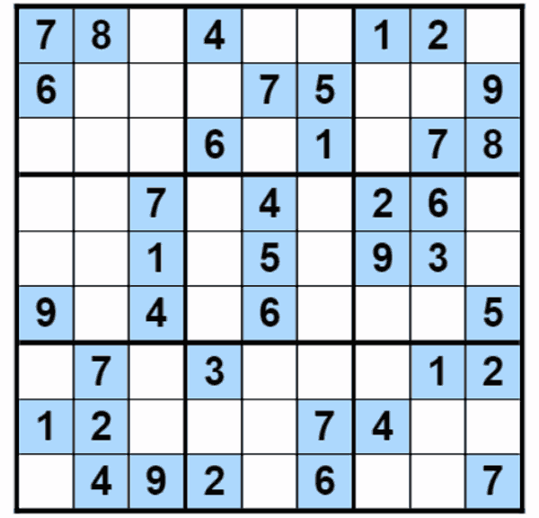
Sudoku Solver
Create a Sudoku Solver and Checker

Slide 12


Sample Input
int mat[9][9] =
{{5,3,0,0,7,0,0,0,0},
{6,0,0,1,9,5,0,0,0},
{0,9,8,0,0,0,0,6,0},
{8,0,0,0,6,0,0,0,3},
{4,0,0,8,0,3,0,0,1},
{7,0,0,0,2,0,0,0,6},
{0,6,0,0,0,0,2,8,0},
{0,0,0,4,1,9,0,0,5},
{0,0,0,0,8,0,0,7,9}};

Slide 13
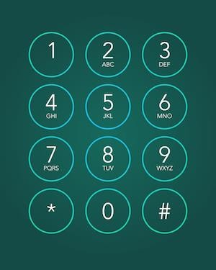
Phone Keypad

Slide 14
N - StairCase ?

Slide 15
Ways in (n*m) empty grid?

Slide 16
Chess E lephant ?

Slide 17
C++
Kartik Mathur

